Slide 1
Troop IL-1956

Slide 3
Trail life usa vision
Our vision is to be the premier national character development organization for young men which produces godly and responsible husbands, fathers, and citizens.

Slide 4
Trail life usa mission
Our Mission is to guide generations of courageous young men to honor God, lead with integrity, serve others, and experience outdoor adventure.

Slide 5
Statements of values
PURITY: God calls us to lives of holiness, being pure of heart, mind, word and deed. We are to reserve sexual activity for the sanctity of marriage, a lifelong commitment before God between a man and a woman.
SERVICE: God calls us to become responsible members of our community and the world through selfless acts that contribute to the welfare of others.
STEWARDSHIP: God calls us to use our God-given time, talents, and money wisely.
INTEGRITY: God calls us to live moral lives that demonstrate an inward motivation to do what is biblically right regardless of the cost.

Slide 6
Trail life motto: Walk Worthy
Colossians 1:10
“So as to walk in a manner worthy of the Lord, fully pleasing to him, bearing fruit in every good work and increasing in the knowledge of God…”

Slide 7
Oath
On my honor, I will do my best
To serve God and my country;
To respect authority;
To be good stewards of creation;
And to treat others as I want to be treated.

Slide 8
Certified Troop il-1956 leaders
Senior Ministry Leader: Dr. Michael Frazier
Troop Ministry Liaison: Timothy Benton
Troop Chaplain: Vince Seals
Troop Chairperson: Tony Cramer
Troop Master: Trevor Boley
Troop Treasurer: Kent Plackett

Slide 9
Fun Activities
See Trail Life Schedules for a list…

Slide 10
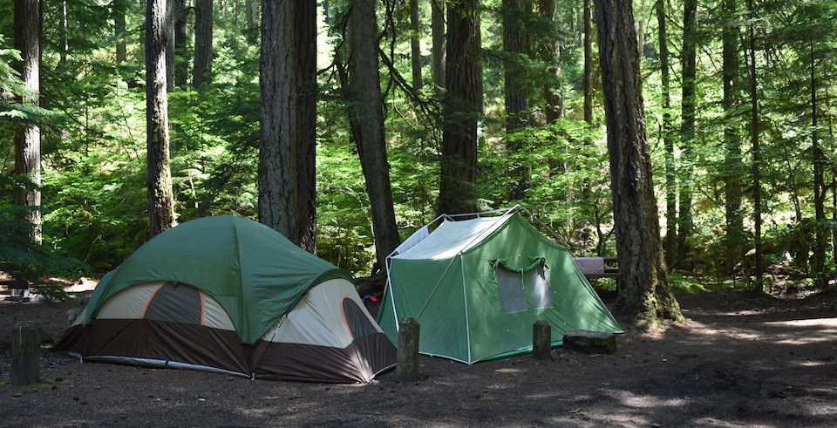
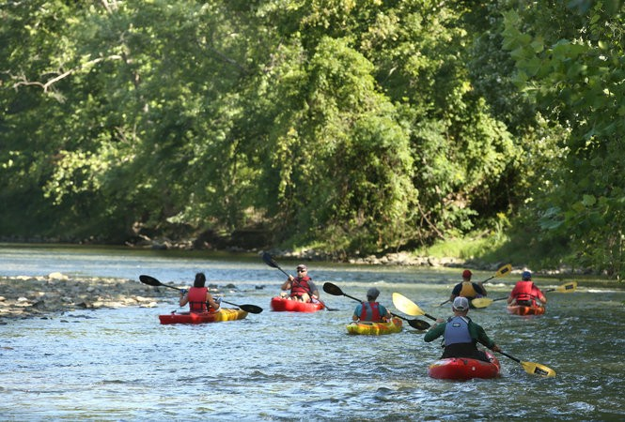
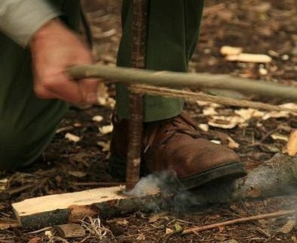
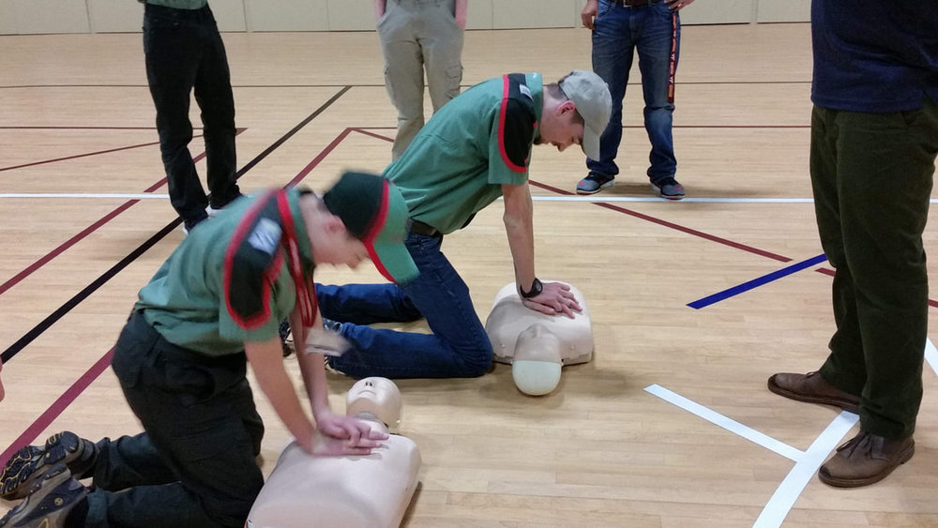

Slide 11
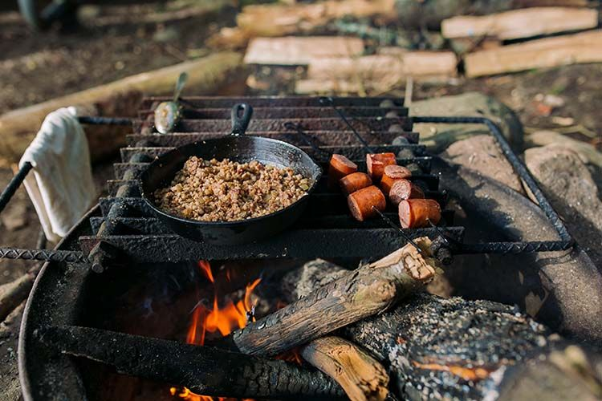
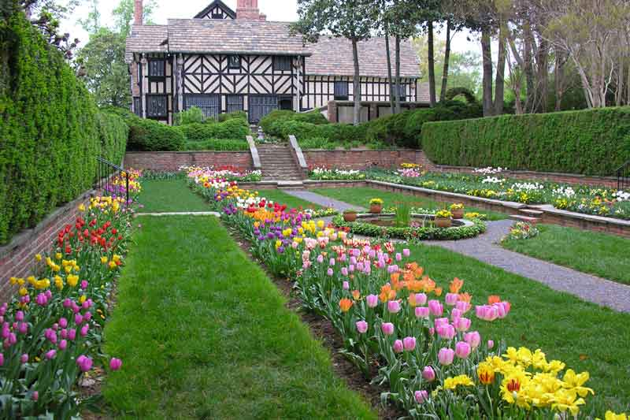
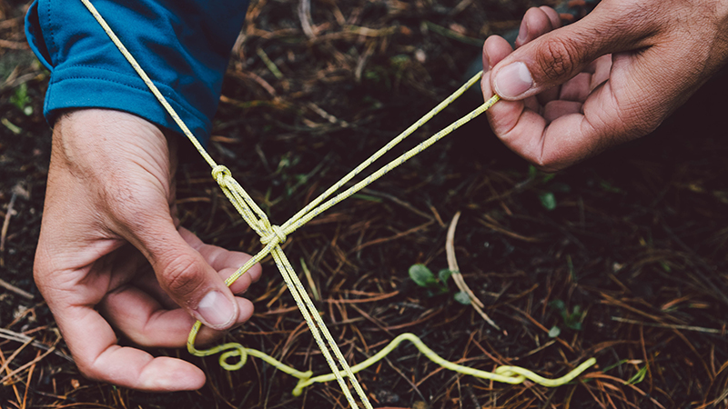

Slide 12
The Programs

Slide 13
Woodlands trail
K-1st (5 years old by October 31)
Fox
2nd-3rd (7 years old by October 31)
Hawks
4th-5th (9 years old by October 31)
Mountain Lions

Slide 14
Advancements in Woodlands K-5th
Mountain Lion
Fox
Hawks

Slide 15
Mountain Lions advancement (4th & 5th)
Heritage Branch (Brown): An exploration of American Heritage, Christian Heritage, and a boy’s own family heritage.
Hobbies Branch (Black): An exploration of various indoor and outdoor hobbies that demand varying levels of knowledge, skill, or aptitude.
Life Skills Branch (Burgundy): Teaching life lessons ranging from the practical and mundane to higher-level interpersonal skill sets.
Outdoor Activities Branch (Green): Having fun in the outdoors with sports and other activities.

Slide 16
Mountain Lions advancement (4th & 5th)
Pioneering Skills Branch (Blue): Gaining basic understanding of woodcraft, hiking, exploration, and camping skills.
Science and Technology Branch (Yellow): An exploration of physical and natural science concerning our created world.
Values Branch (Red): Instilling Biblical-based values within the boys regarding any number of pertinent topics. The central focus of this branch is teachings of the Christian faith.

Slide 17
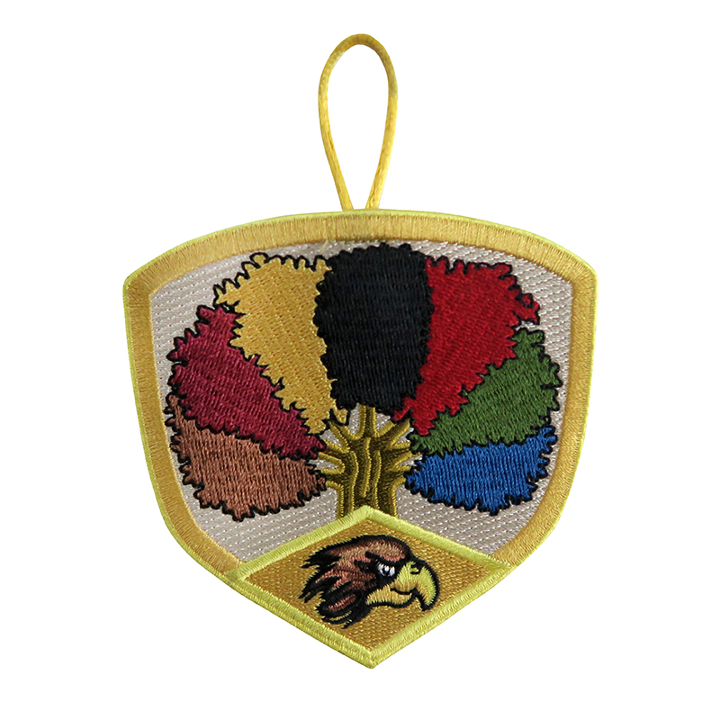

Slide 18
navigators
Memorize and agree to live by the Trailman Oath.
Memorize the Trailman motto.
Demonstrate the Trailman sign & when to use it.
Demonstrate the Trailman salute & when to use it.
Give your patrol Leaders name, patrol name and patrol yell.
Traditions

Slide 19
navigators
Memorize the pledge of allegiance.
Demonstrate properly folding the American Flag.
Citizenship

Slide 20
navigators
Participate in a Troop annual safety program or discuss Troop safety with your Unit Leader and parents.
Safety

Slide 21
navigators
15 hours of community service
Participate in 16 Troop activities since becoming a Navigator

Slide 22
Troop IL-1956 Meetings
1 hour 15 to 30 minutes
Flag ceremony
Oath & motto
Spiritual lesson: Troop Chaplain
Prayer of dismissal to groups
Group activities (badge work)
Closing: announcements & other issues

Slide 23
What Time is required of me?
We are a parent involved troop. The more we pour into your child, the more they will grow.
We have 2 meetings a month on Sunday evenings at 6 pm. (Check schedules)
Additional opportunities such as service, campouts, hikes, field trips at least once a month.
Awards ceremony October 4, 2020.

Slide 24
Frequently Asked Questions

Slide 25
F.A.Q.
How do we communicate? We use Troop Track to stay in touch with parents by email. Also, our Facebook page.
What about mom’s? We encourage mother’s to help.
Do the kids need uniforms? Yes. Try to purchase them as soon as you can.
Do the kids need books? Yes. Every child needs a book.

Slide 26
F.A.Q.
How much does it cost?
A yearly fee of $26 paid directly to Trail Life USA.
How much are dues?
$50 a year per child (one time payment)
Or $5 a month per child
What is not covered by the dues?
Campouts, special events, and any activity done by the troop: field trips, etc.

Slide 27
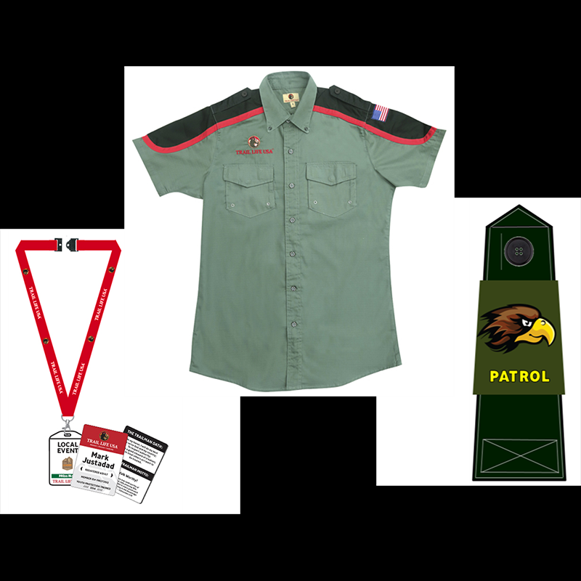
F.A.Q. (Option 1)
New Trailman Package A
$50

Slide 28
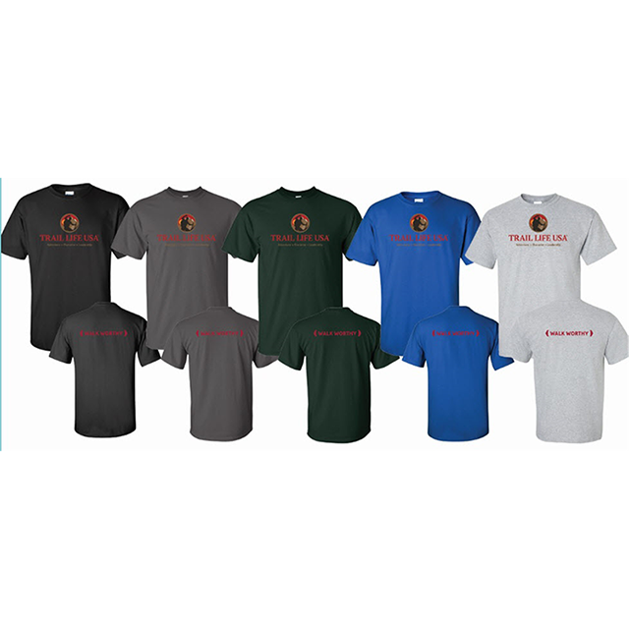
F.A.Q. (Option 2)
Adventure, Character, Leadership
T-Shirt w/logo
$12-18

Slide 30
F.A.Q.
Woodlands Handbook
$17.50
Navigator Handbook
$17.00

Slide 31
F.A.Q. (Option 1)
Trail Life Yearly Membership: $26.00
Troop Dues: $50 a year
Trail Life Uniform: $50
Trail Life Books: $17.50 (Woodland) $17.00 (Navigator)
$143.50

Slide 32
F.A.Q. (Option 2)
Trail Life Yearly Membership: $26.00
Troop Dues $5 a month (ongoing)
Trail Life Uniform T-Shirt: $18.00
Trail Life Books: $17.50 (Woodland) $17.00 (Navigator)
$66.00

Slide 33
How to Join?
Fill out the sign up sheet. (Legible please)
I will then enter your information into our Troop Track account.
You will receive an email from Troop IL-1956 with a link.
Click the link, pay Trail Life USA $26.
Go to Trail Life USA and purchase books & T-Shirt. www.traillifeusa.com

Slide 34
Q & A

Slide 35
Troop IL-1956

